Slide 1

Prerequisites and FAQs for beginners and intermediate learners in Machine Learning

Slide 2
Prerequisites & Prework
Let’s get started with exactly WHAT are the prerequisites and prework that needs to be done before getting started in Machine Learning.

Slide 3
BASIC:
It is recommended that anyone getting started with Machine Learning should meet the following prerequisites:
You must be comfortable with variables, linear equations, graphs of functions, histograms, and statistical means.
You should be a good programmer. Ideally, you should have some experience programming in Python.

Slide 4
Algebra:
Variables, coefficients, and functions
Linear equations such as [ y = b + w₁x₁ + w₂x₂ ]
Logarithms, and logarithmic equations such as [ y = ln(1 + e^{Z}) ]
Sigmoid function
Linear Algebra:
Vectors, vector spaces, and tensors
Matrix and determinants
Matrix multiplication and decomposition
Eigen vectors and eigen values

Slide 5
Statistics:
Mean, median, outliers, and standard deviation
Ability to read a histogram
Calculus(for deeper dive):
Concept of a derivative
Gradient or slope
Partial derivatives (which are closely related to gradients)
Chain rule

Slide 6
Python Programming:
defining and calling functions, using positional and keyword parameters
dictionaries, lists, sets (creating, accessing, and iterating)
for loops, for loops with multiple iterator variables
(e.g., for a, b in [(1,2), (3,4)])
if/else conditional blocks and conditional expressions
string formatting (e.g., '%.2f' % 3.14)
variables, assignment, basic data types (int, float, bool, str)
list comprehensions

Slide 7
Tools & Technologies
With prerequisites off the hook, let’s move forward to WHAT tools and libraries are recommended for beginners and intermediate learners in Machine Learning.

Slide 8
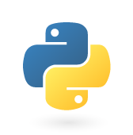


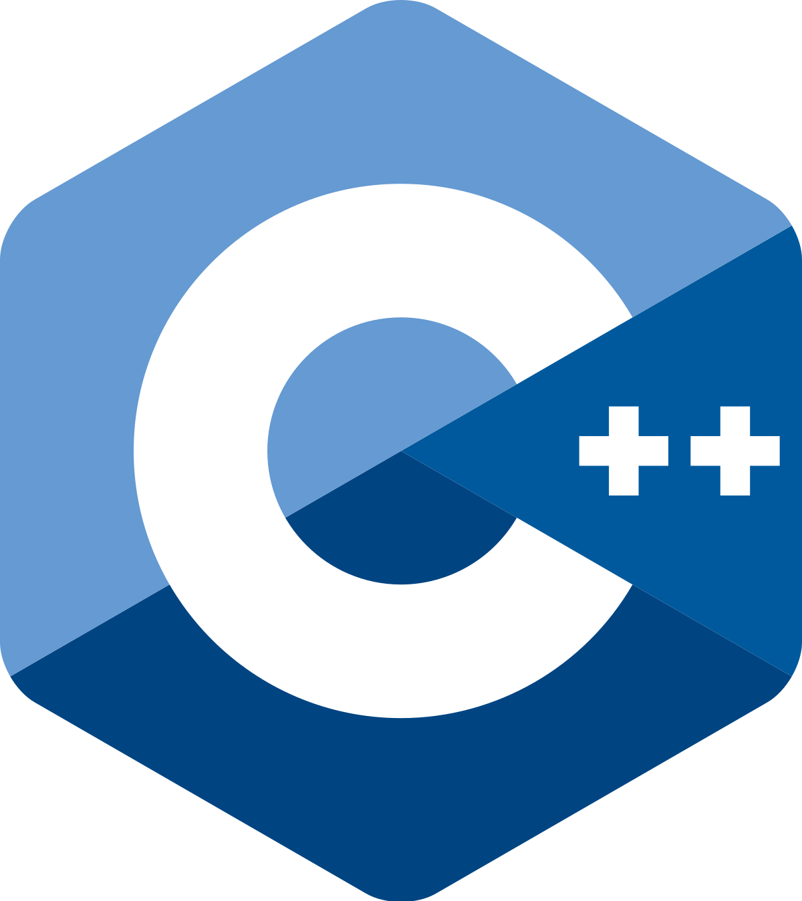
Programming Languages:
Python: An object-oriented, easy-to-use and developer friendly language with a vast ecosystem of high-quality machine learning and data analysis libraries.
JavaScript: A multi-paradigm and event-driven scripting language preferred for its interactive and rich visualizations and handling of real time data.
R: A high-level language for statistical computing and graphical analysis.
C++: A middle-level language preferred for its highly optimized results and used for designing the cores of popular libraries like NumPy and TensorFlow.

Slide 9

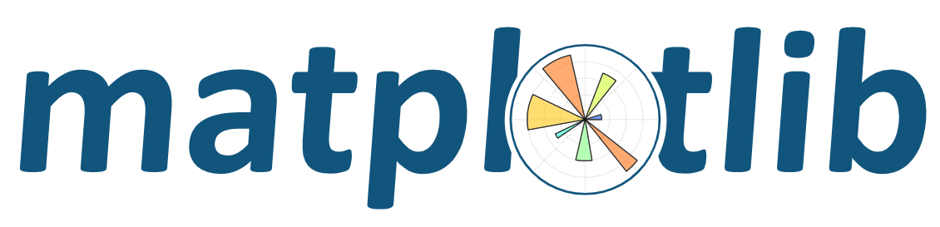

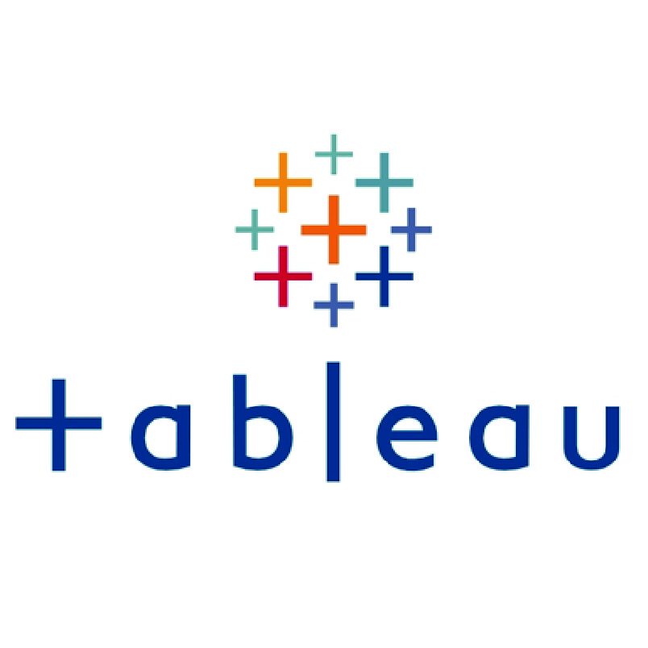
Data Analytics and Visualization:
Pandas: A python data analysis library which provides an easy way to represent datasets in memory and enhances analytics.
Matplotlib: A python plotting library for generating production-quality static, animated, and interactive visualizations with a few lines of code.
Jupyter notebook: A free web application for interactive computing to script, develop and execute code in numerous languages, including Python, R, Scala and Julia.
Tableau: A data visualization tool used in data science and business intelligence for quickly extracting insights from data presenting them in understandable formats.

Slide 10

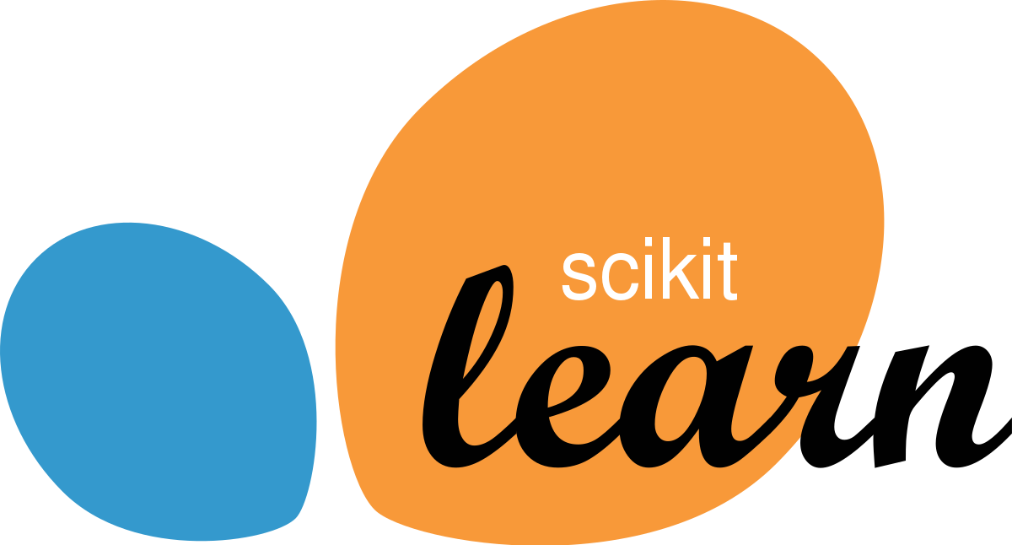

Frameworks for General Machine Learning (Python):
NumPy: An extension package for scientific computing with Python which includes operations on multi-dimensional arrays, linear algebra, and random number capabilities.
Scikit-learn: An open source, easy-to-use Python machine learning library built on top of SciPy, NumPy, and matplotlib.
NLTK: A Python-based platform for the development of human language data processing. It’s pretty much a standard library for text processing.
statsmodels: A Python package that provides a complement to SciPy for statistical computations and models which includes time-series analysis along with others.

Slide 11
Can you guess which of the given two libraries is more commonly used in general ML modeling tasks? 1. scikit-learn 2. statsmodels
Quick Question!
(mention in the chat box)

Slide 12
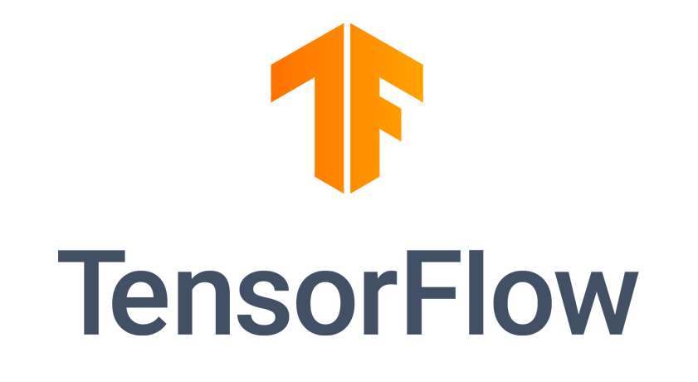


Frameworks for Deep Learning (Python):
TensorFlow: An open source software library for machine learning and deep neural network research and recurring tasks developed and released by the Google Brain Team.
Keras: A lightweight and easy-to-use Python deep learning library built on top of TensorFlow for fast prototyping of machine learning experiments.
PyTorch: An open source, easy-to-use machine learning framework for deep neural network research and recurrent tasks that supports and accelerates GPUs developed for fast and flexible modeling experience. It was developed by the Facebook’s AI Research Lab.

Slide 13
With the short description I just provided, which framework will you prefer for your Deep Learning tasks? 1. TensorFlow 2. PyTorch
Quick Poll!
(mention in the chat box)

Slide 14
The BIG Question: TensorFlow or PyTorch
The preference over these two frameworks is based on the following factors:
1. Style:
PyTorch is very natural to use for Python Programmers because of its easy and interpretable implementation. It works the way you had expected it to, without much complex details.
TensorFlow supports more coding languages than PyTorch, like JavaScript and Swift. If you don’t want to write much low-level code, then you can use it’s high-level API, Keras for abstracting away the finer details.

Slide 15
2. Data and Model:
If you want to use a specific pretrained model, then you should research what it’s compatible with. Some models are available in only one of them while some are available on both.
If you want to use preprocessed data, then it may already be built into one library or the other.
3. Project Goal:
If you want to deploy a model on mobile devices, then TensorFlow is better because of TensorFlow Lite and its Swift API.
For serving models, TensorFlow has tight integration with Google Cloud, but PyTorch is integrated into TorchServe on AWS.
If you want to enter Kaggle competitions, generally, Keras will let you quickly iterate over experiments.

Slide 16
I’ve done some courses in ML/DL/DS, what now?
Taking up MOOCs on ML/DL/DS is not enough to get you Jobs/Internships in these fields.

Slide 17

So, as intermediate learners, you should keep the following points in mind:
Projects: Don’t just stop with Capstones. Try to implement what you’ve learned to your own Projects and problem statements and explore a bit further on your own.
Kaggle Competitions: Once you are familiarized with prototyping ML models to a few datasets and self projects, try competing in Kaggle. It will serve as a challenge to try out different types of models on a variety of datasets and will help you to gather insight on solving problems with ML.
Hackathons: Try to participate in a variety of Hackathons and Datathons to test out and implement your unique ideas to an end-to-end projects within the provided deadline using these technologies. This will immensely help you to broaden your knowledge and not be confined to just ML.

Slide 18
Thank you

